Slide 1
Huffman cODING aLGORITM

Slide 2

WHAT IS HUFFMAN CODING ALGORITHM?
Huffman Algorithm was developed by David Huffman in 1951.
Huffman coding is a lossless data compression algorithm.
In this algorithm, a variable-length code is assigned to input different characters. The code length is related to how frequently characters are used. Most frequent characters have the smallest codes and longer codes for least frequent characters.
There are mainly two steps. First one to create a Huffman tree, and another one to traverse the tree to find codes.
This technique is a mother of all data compression scheme.
Huffman tree is a specific method of representing each symbol.
This technique produces a code in such a manner that no codeword is a prefix of some other code word. These codes are called as prefix code

Slide 3
What do we do?
We will take out two nodes of minimum values, and store it in another tree, then again repeat the process.
Let’s see how.

Slide 4
Example
Suppose A,B,C,D,E,F,G and H are 8 data items with weights 22,5,11,19,2,11,25,5. Construct a tree with minimum weighted path length using Huffman’s Algorithm.

Slide 5
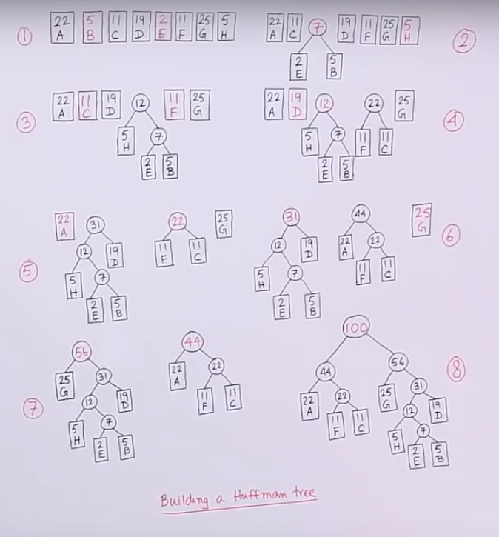
Steps

Slide 6

Next step
We will assign 0 and 1 to child node on left and right respectively
85
0
1
A 23
B 62

Slide 7
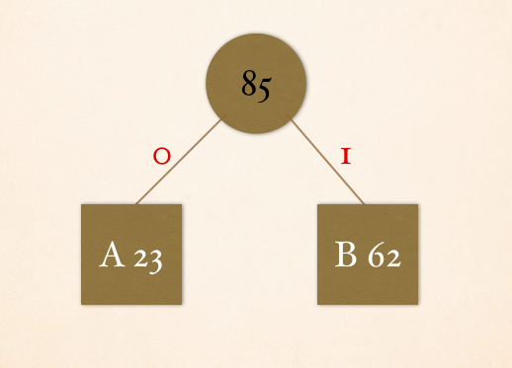
Next step
To find code for a particular node we will traverse till that node.
A-0 B-1

